Slide 1

SAT - 5141 GROUP - 5
Maternal Health Risk Prediction and Assessment
Kimaya Havle
Sifat Naseem

Slide 2
Why Maternal Health Prediction?
In order to care for the growing fetus and get the mother ready for labor and delivery
Crucial to distinguish between normal physiological changes and disease pathology
According to the CDC, In 2019, around 754 women died due to complicated pregnancy. The number went up to 861 in 2020, which further increased to 1,205 in 2021 in the USA, which is alarming

Slide 3
Justification of the population selected:
•Target study population is 1,014 women between 10 and 70 years of age
•The prediction is based on 6 features and a target label values of low risk, mid risk and high risk
•The focus of this study is to predict and assess the risk factors for maternal health

Slide 4
Literature review:
AI-driven technologies have the potential to improve the healthcare provided to pregnant women ^{[1]}
Yuhan Du et al. states that using machine learning algorithms can significantly improve pregnancy care aspects in women. However, the models require explainability and interpretability ^{[2]}
Ahmed et al. emphasize leveraging IoT to monitor maternal health, especially in remote areas or for mothers with limited access to healthcare ^{[3]}

Slide 5
Literature review:
Early detection via machine learning techniques and efficient data sharing with medical experts can aid in reducing maternal mortality ^{[4]}
Ensemble techniques can enhance the generalizability and effectiveness of maternal health risk assessment models.^{[5]}
Machine learning-based CDSS is nowadays a potential research area widely used to improve pregnancy outcomes in clinical practice, especially to make informed decisions.^{[6]}

Slide 6




How literature review influenced project:
Addressed research gaps
Narrowed down on
optimal models
Addressed Explainable AI
Leveraged AI driven Tech

Slide 7
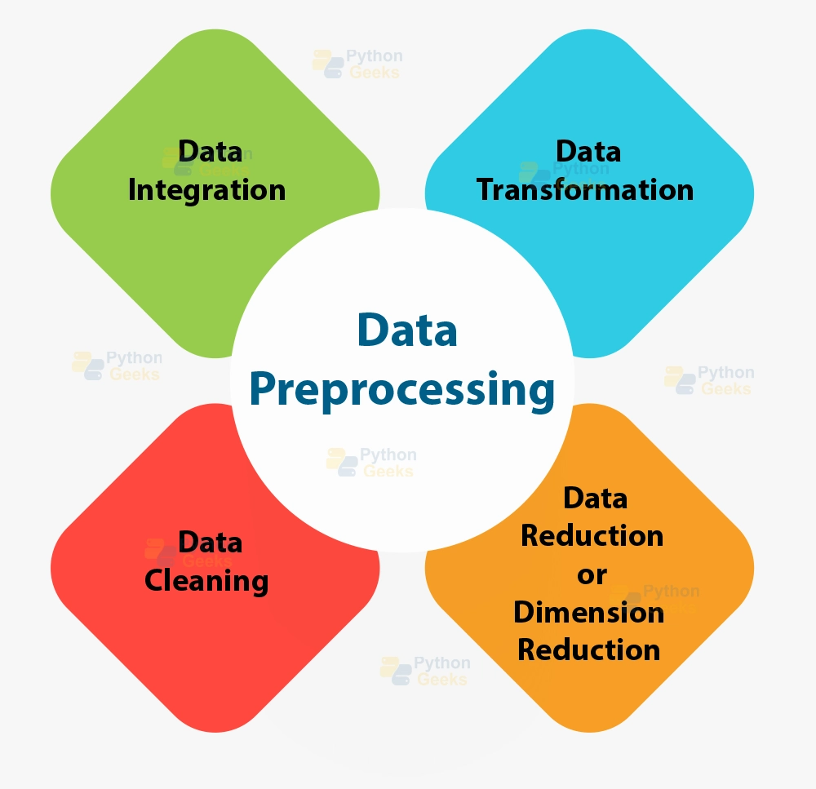
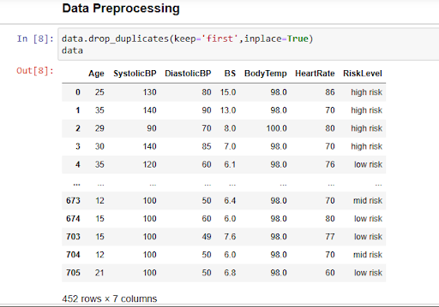
Data Preprocessing:

Slide 8
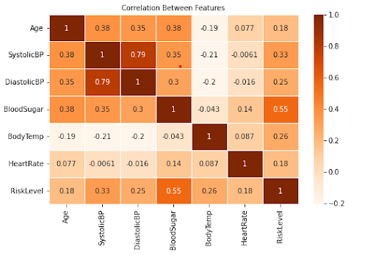
Correlation Graph

Slide 9
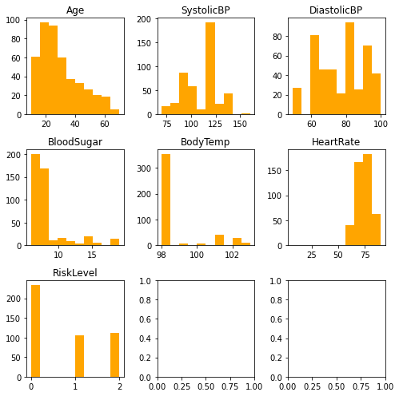
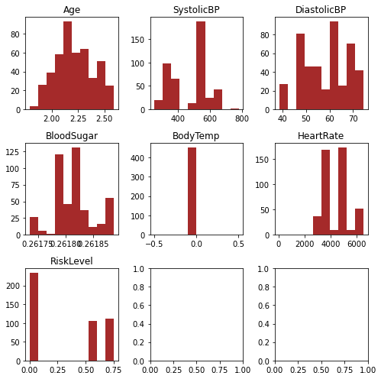
Exploratory Data Analysis
Box Cox Transformation

Slide 10
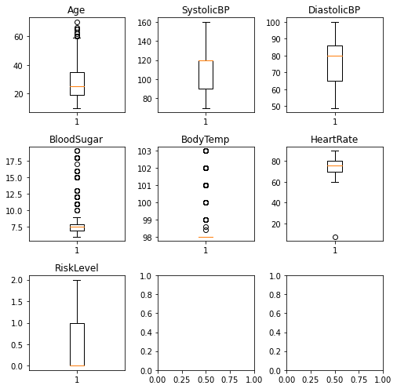
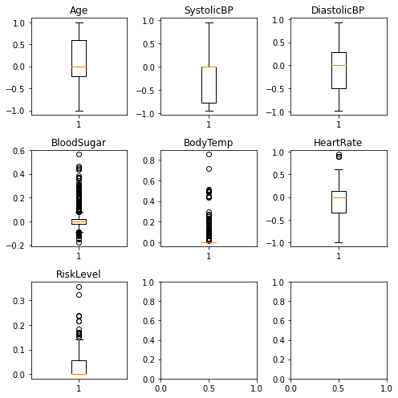
Exploratory Data Analysis
Spatial Sign Transformation

Slide 11
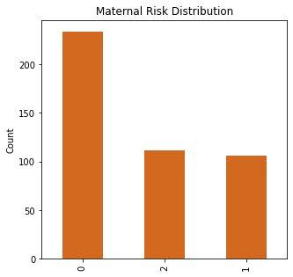
Target variable distribution
Count -
Low risk (0) - 234
Mid risk (1) - 112
High risk (2) - 106

Slide 12
Models used -
Classifier | Computational Time | Accuracy | Precision | Recall | F1
KNN | 0.009 | 0.681 | 0.658 | 0.681 | 0.653
Random Forest | 0.102 | 0.725 | 0.680 | 0.725 | 0.678
Adaboost | 0.069 | 0.615 | 0.620 | 0.615 | 0.617
Gradient Boost | 0.167 | 0.648 | 0.629 | 0.648 | 0.637

Slide 13
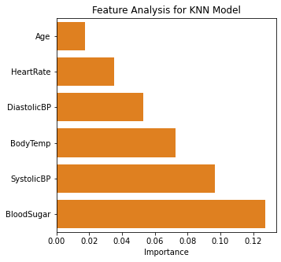
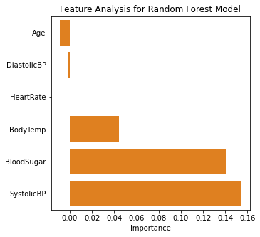
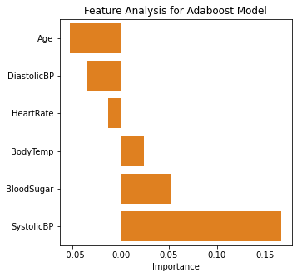
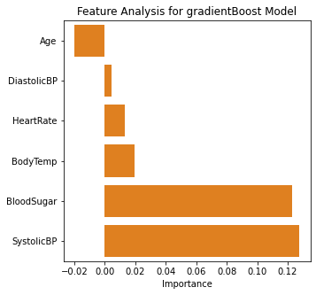
Feature Importance -

Slide 14
Which model was optimal?
•Random Forest is the most optimal model
Accuracy- 72 %
F-1 score- 0.67
Best Feature- Blood Sugar, Systolic BP
•It uses multiple weak predictors to give a strong predictions
•Good prediction power for multi - class problems

Slide 15
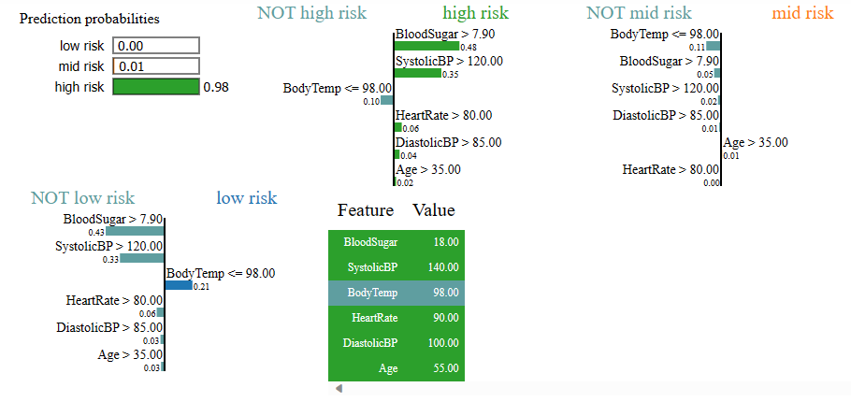
Explainability and Interpretability - LIME
Notes:
A technique that approximates any black box ML model with a local interpretable model to explain each individual prediction

Slide 16

Application interface

Slide 17

What other tools could we have used?
Deep Learning -
Requires large data
Computationally Expensive
Shapley for explainability -
Global interpretation
Computationally Expensive compared to LIME
Notes:
Shapley - 1) Explains the overall impact of each features across all predictions
Lime - 1) Explains a models prediction for a specific instance rather than the overall behaviour of the model
2) More intuitive and simple
3) More granular
4) Computationally less expensive

Slide 18

Strength of the dataset
Easy availability
Good interpretability
Less computational time and resources required
Notes:
Interpretability - the degree to which we can understand the cause of a decision.

Slide 19

Weakness of the dataset
Limited dataset
Excessive duplicate records
Cannot be used for deep learning

Slide 20

Limitations of the study
Inadequate dataset to try complex models
Less evidence for determining the role of SDOH in maternal health risk prediction

Slide 21
Conclusion of the Project Findings
For this dataset, Random Forest has the highest accuracy and F1 score of 72.52% and 0.67 respectively
Based on feature correlation and analysis, Blood Sugar and Systolic Blood Pressure are the highest contributing predictors for maternal health risk
Wider dataset with more physiological features along with SDOH should be collected

Slide 22

Recommendations to improve our measures
Use of a dataset that focuses more on the target population age group
Find a larger dataset, with more predictors, to perform deep learning analysis
Obtain a dataset that is geographically diverse with the support of GIS
Include social determinants of health as features for maternal health risk prediction

Slide 23

How feasible are the recommendations?
Obtaining data from hospitals, clinical settings through EHRs website can be feasible
However, obtaining geographic and information on SDOH of the participants would require multiple stakeholder involvement due to legal and ethical requirements.

Slide 24
References -
https://www.google.com/books/edition/Informatics_and_Technology_in_Clinical_C/2tluEAAAQBAJ?hl=en&gbpv=1&pg=PA333&printsec=frontcover
https://www.sciencedirect.com/science/article/pii/S1386505623000588
https://ieeexplore.ieee.org/abstract/document/935032
https://link.springer.com/chapter/10.1007/978-981-15-2317-5_3
https://pubmed.ncbi.nlm.nih.gov/36907027/
https://journals.plos.org/plosone/article?id=10.1371/journal.pone.0276525
https://journals.plos.org/plosone/article?id=10.1371/journal.pone.0276525

Slide 25


